Slide 1
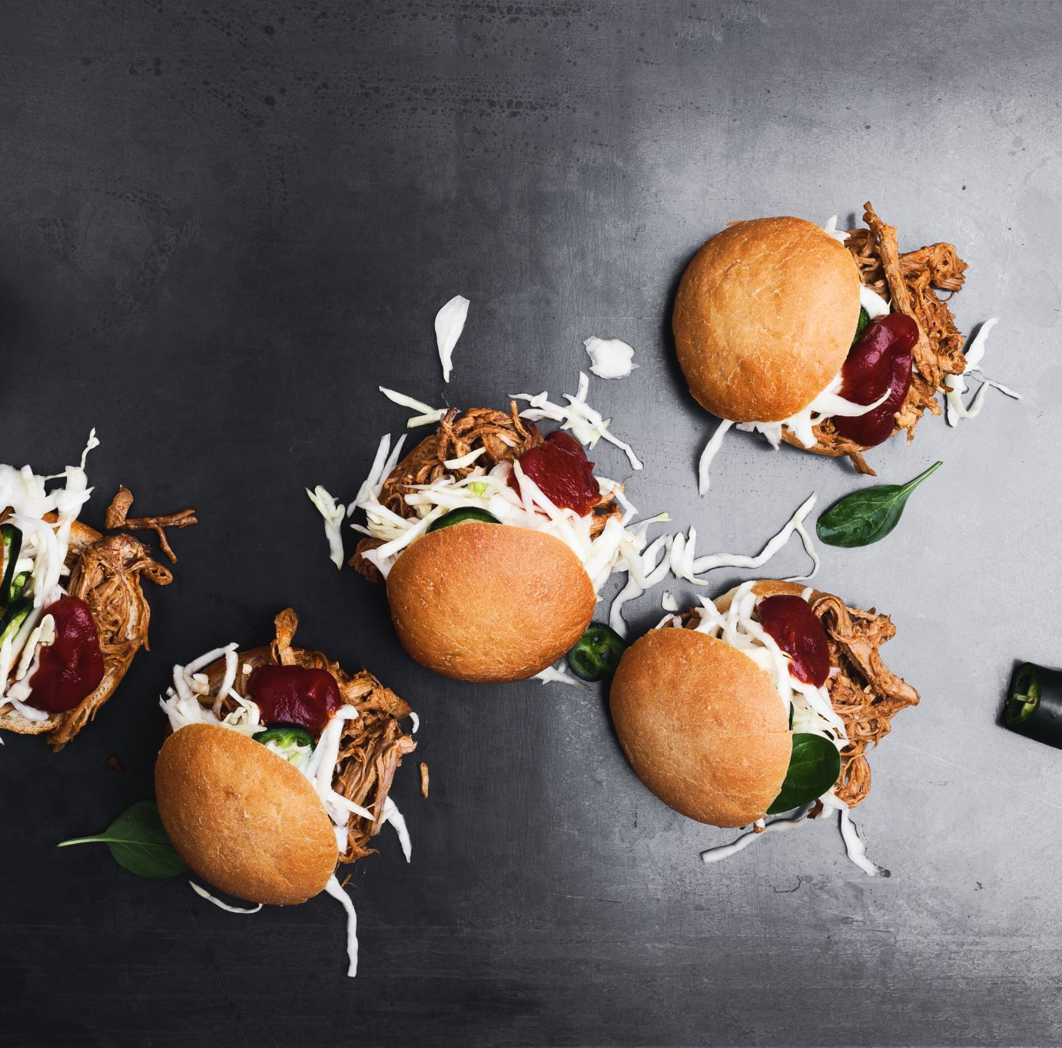
TASTY BITES FOOD DELIVERY
BY VISHNU JAISWAL

Slide 2
BUSINESS SCENARIO AND OBJECTIVES
IDENTIFICATION OF HIGH AND LOW PROFITS PRODUCTS
1
CUSTOMIZE THE PRICING TO GAIN MAXIMUM PROFITIBILITY
2
TO UNDERSTAND THE PATTERNS OF DISCOUNTS AND PROMOTIONS
3

Slide 3
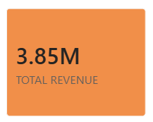
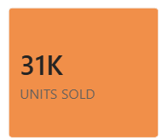
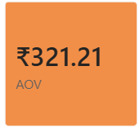
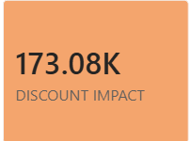
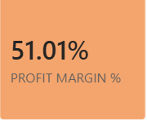
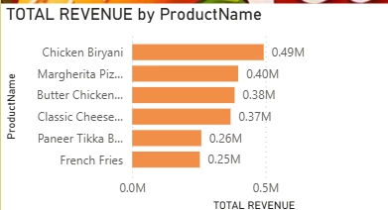
INSIGHTS AND BUSINESS AT A GLANCE

Slide 4
INSIGHTS GAIN BY THE DATASET
TASTY BITES GAIN A TOTAL REVENUE OF RS 38.5 LAKHS AND A PROFIT OF 19.7 LAKHS WHICH IS VERY COMPATIBLE NUMBERS BUT THE NUMBERS CAN BE MORE BETTER
OVERALL PROFIT MARGIN OF TASTY BITES IS OF 51%
THE ORDERS PLACED BY THE CUSTOMERS HAVE A AVERAGE ORDER VALUE OF 321
TASTY BITES HAVE LOST ALMOST 1.73 LAKHS OF RUPEES AFTER GIVING THE DISCOUNT

Slide 5
TOP PRODUCTS WHO DRIVES THE MAX PROFIT
BEVERAGES HAVE CONTRIBUTE 24.7% OF PROFIT IN TOTAL PROFIT OF TASTY BITES
SNACKS HAVE DRIVES OUT THE PROFIT OF ALMOST 32.4% FOR TASTY BITES
MEALS BRINGS MOST IN CASH AND THE THINEST PROFIT FOR TASTY BITES

Slide 6

PRODUCT FALL BEHIND
CLASSIC CHEESBURGER HAVE BEEN SEEN TO BE THE LEAST PROFIT GENERATOR FOR TASTY BITES AND THIS PRODUCT HAVE 1743 OF TOTAL UNITS SOLD WHICH IS VERY GOOD IN NUMBERS

Slide 7
WHAT THE DATA IS TELLING TO US
HIGH VOLUME IS NOT EQUAL TO HIGH PROFIT GENERATIONS SO WE CAN’T SAY THAT IF ANY PRODUCT HAVE HIGHER UNITS SOLD THAT CAN LEAD TO MORE PROFIT GENERATIONS
BEVERAGES IS FIND TO BE THE MOST SUCCESFULL PRODUCT WHEN THE TOPIC IS PROFIT GENERATIONS
HEAVY DISCOUNTS LEAD TO ERODE MARGINS SO WE HAVE TO WORK TO CUSTOMIZE THE DISCOUNT ACCORDING TO NEED

Slide 8
RECOMMENDATION
QUICKS WINS
CAP THE DISCOUNTS ON CLASSIC CHESSBURGERS AND CHICKEN BIRYNANI
PROMOTE BEVERAGES AND SNACKS MORE TO GAIN HIGH MARGINS
FOCUS ON HIGH MARGINS PRODUCTS CUSTOMERS ONLY
LONG TERM STRATEGY
BUNDLE LOW MARGINS MEALS WITH HIGH MARGINS MEALS TO LIFT THE MARGIN BUCKET
CUSTOMIZE THE DISCOUNTING TO CHECK THE CUSTOMER SENSTIVITY

Slide 9

THANK YOU
END

